Slide 1
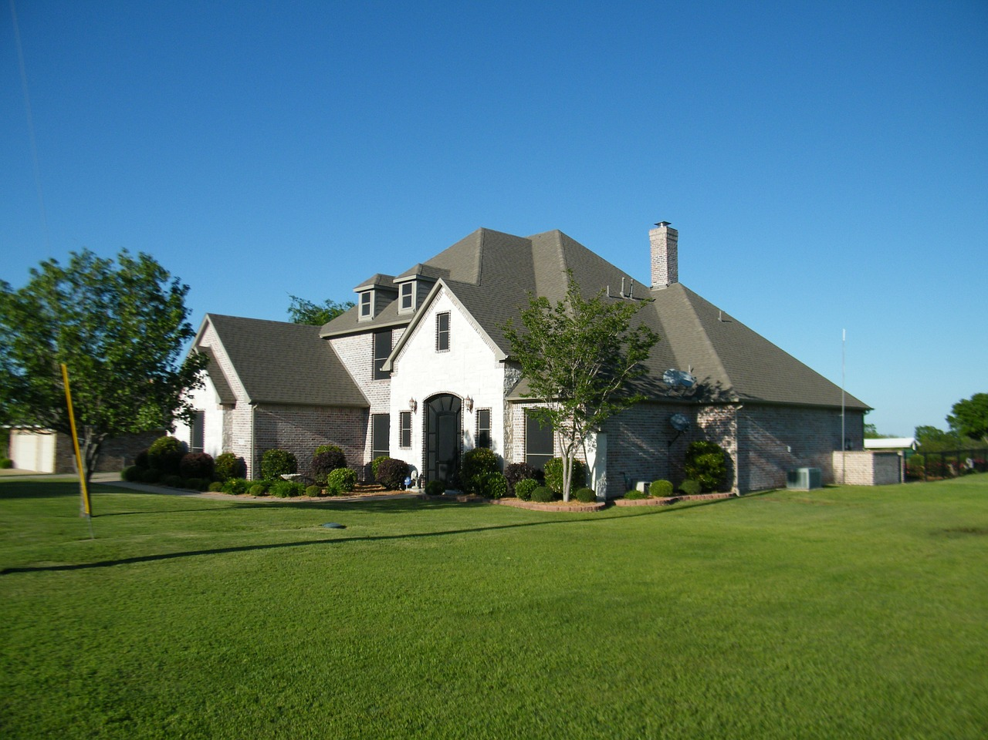
The Problem
Suburban lawns have replaced native habitats. Unfortunately, perfect lawns have ugly effects on the environment.

Slide 2
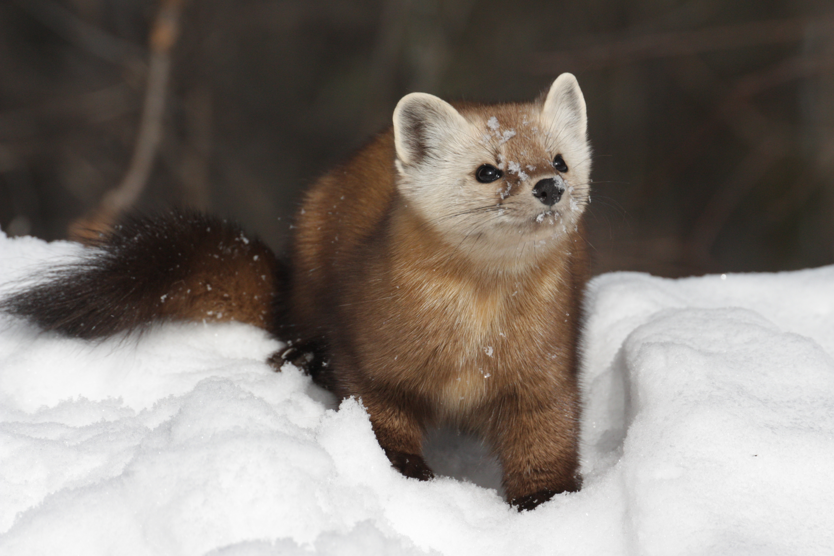
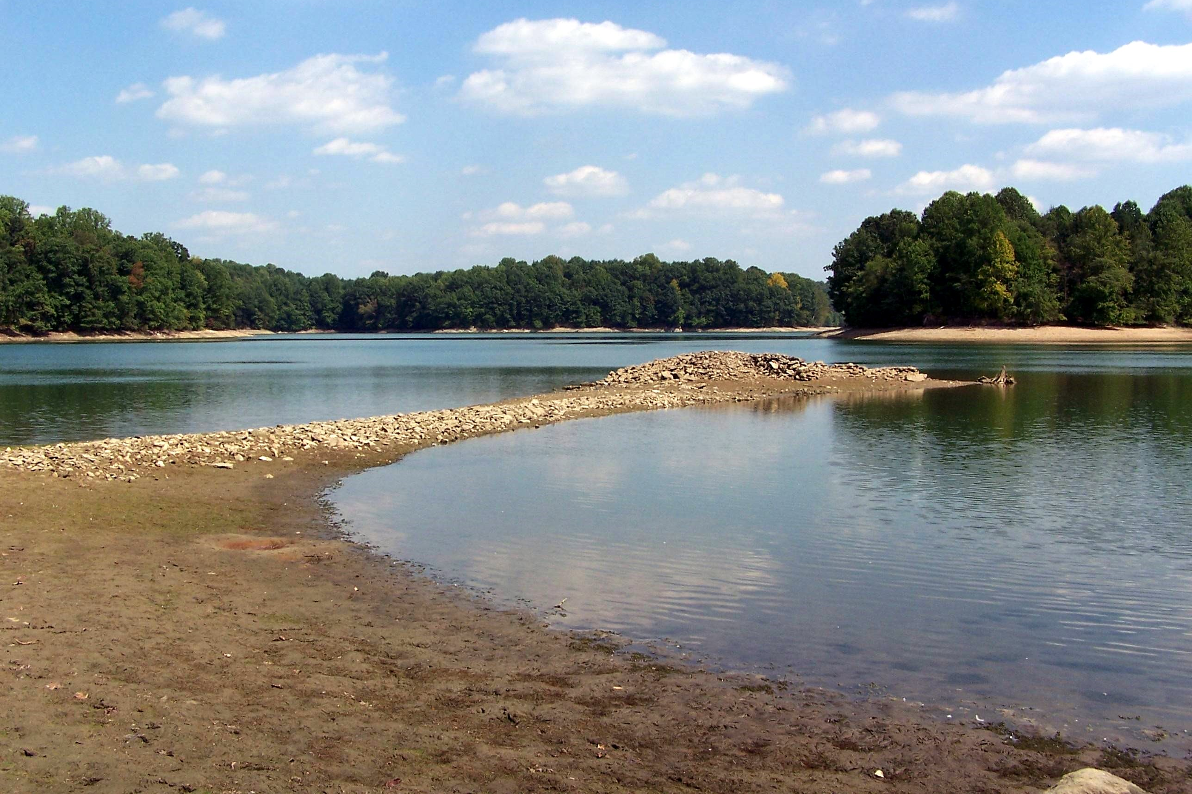
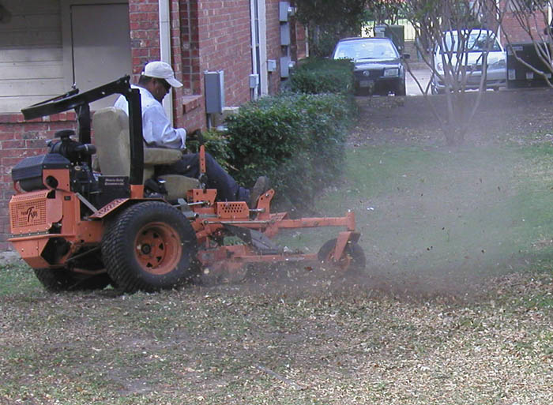
Consequences
Habitat Loss
Turf-grass lawns have little or no value for wildlife. Lawns don’t provide enough food or shelter for most animals.
1
Water Usage
Watering lawns can consume billions of gallons of water a day. This drains our limited water resources.
2
Pollution
Lawns are major sources of pollution. Lawn fertilizers and pesticides pollute our waterways, and gas-powered lawnmowers pollute our air.
3

Slide 3
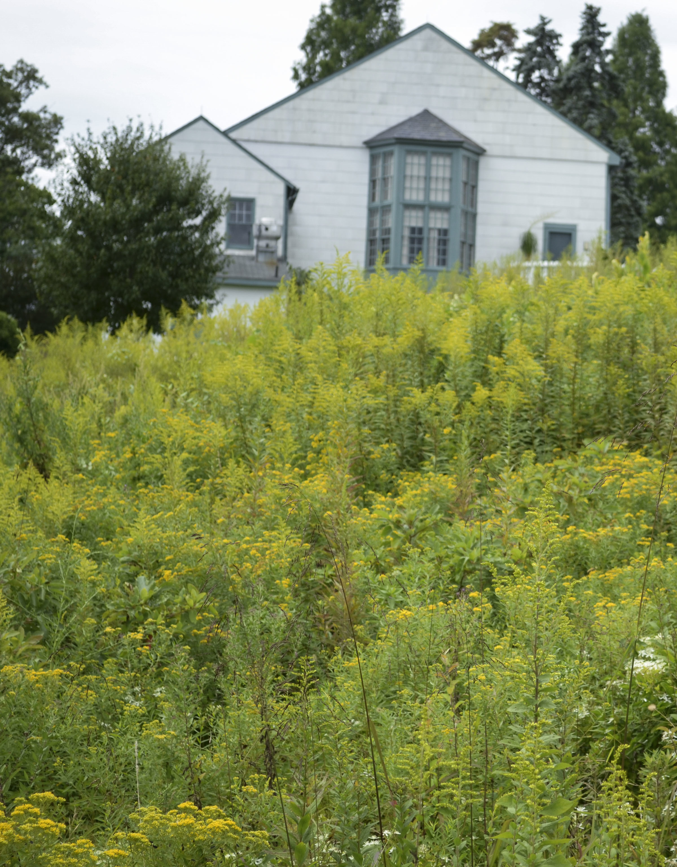
1
What Can You Do about It?
Add native plants
Use native plants to create rich habitat for wildlife, while reducing the need to water and mow.
Convert some of your existing lawn into a native garden. Include native trees, shrubs, wildflowers, and ground covers.
Replace existing grass with native, drought-tolerant grasses.

Slide 4
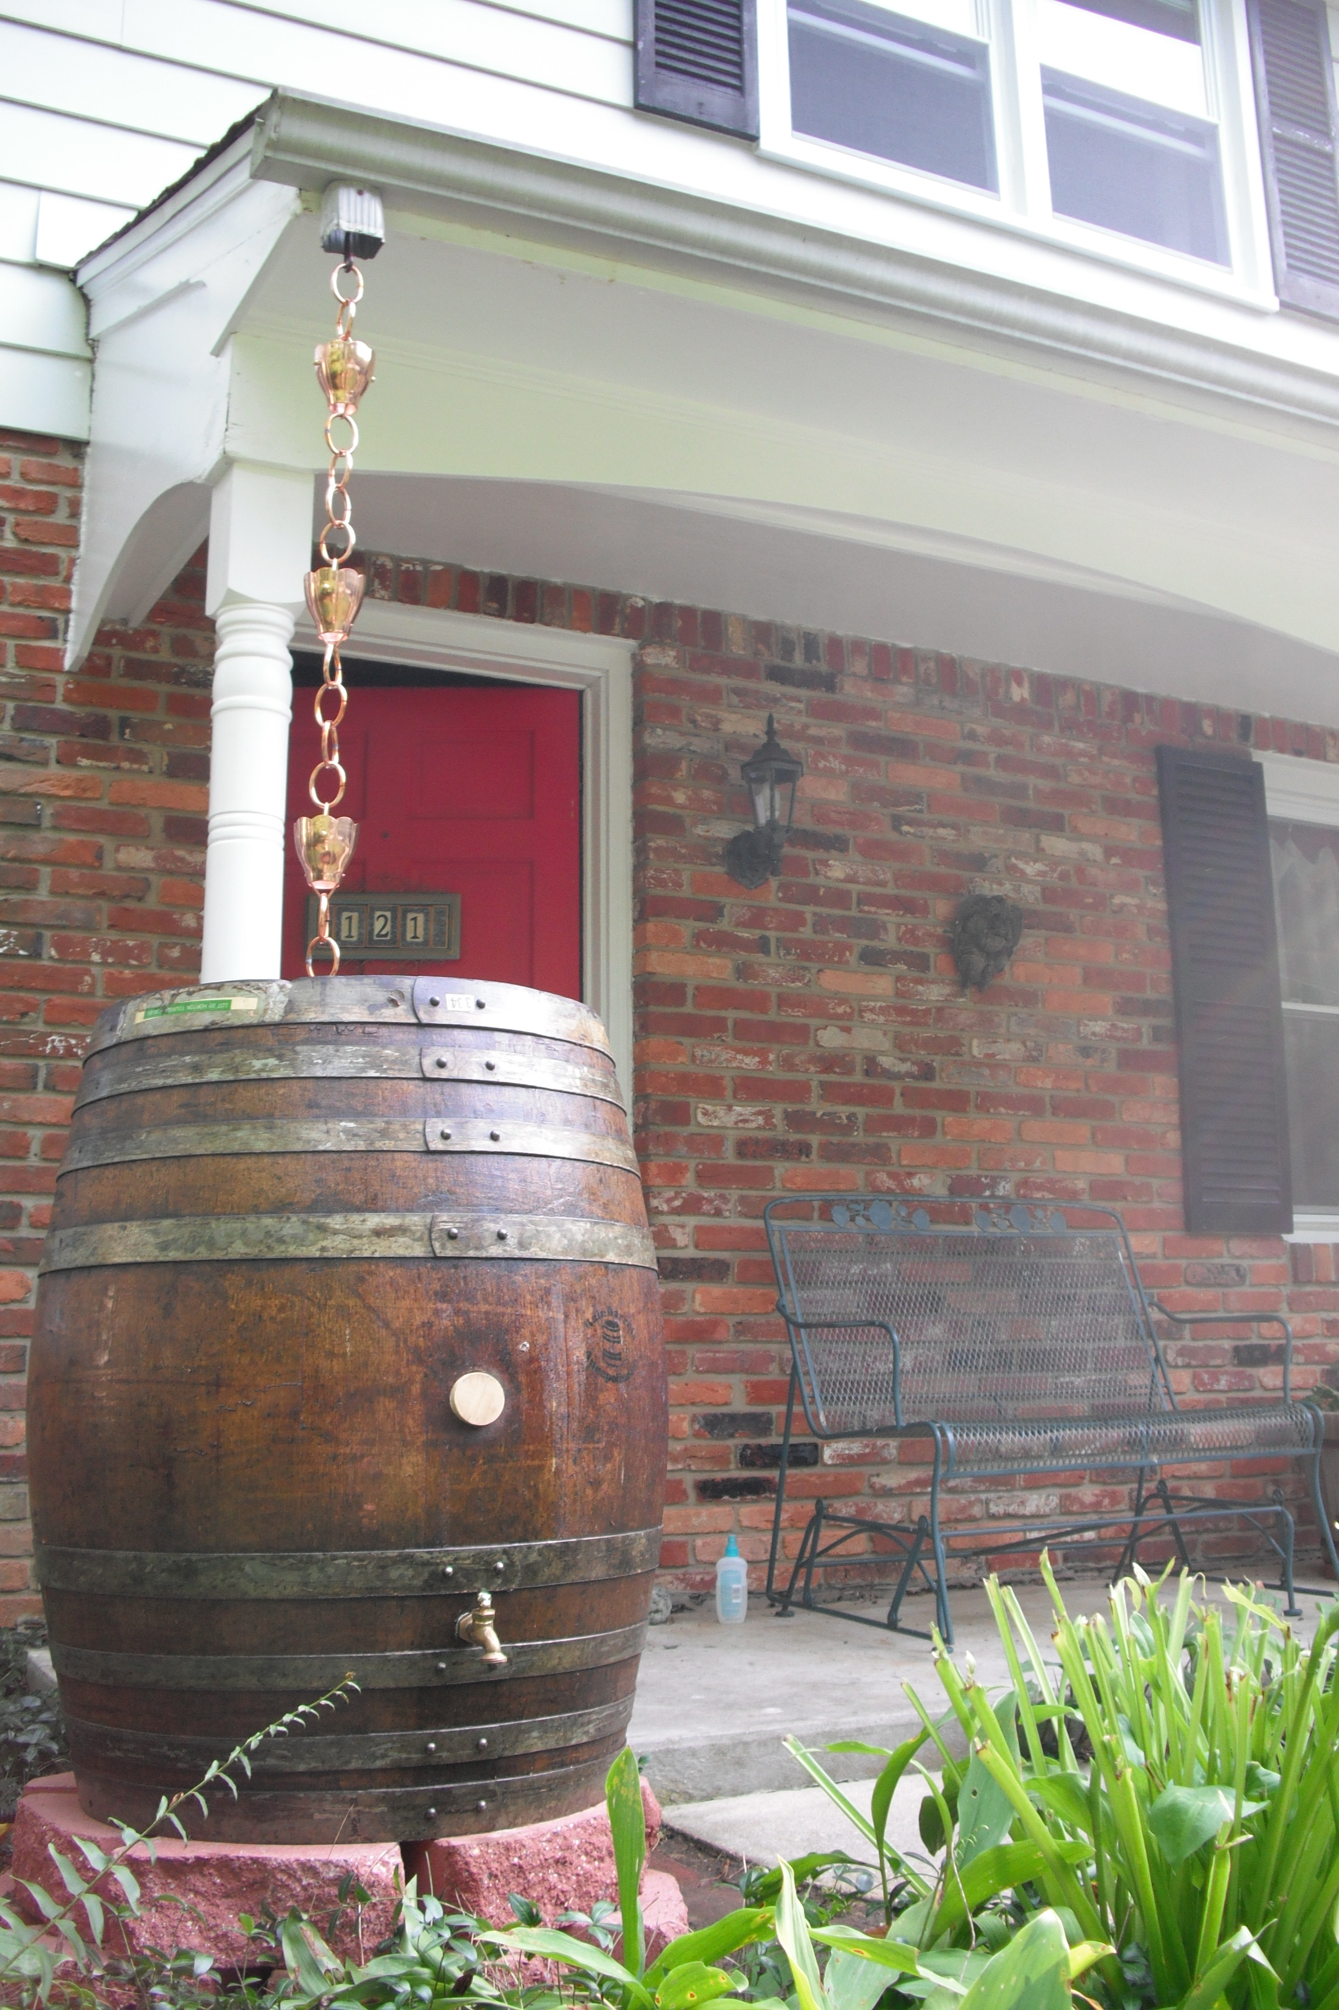
2
What Can You Do about It?
Use water wisely
Water less. If your grass springs back when stepped on, it doesn’t need watering.
Water in the early morning so less of it evaporates.
Set up rain barrel(s) to collect water from your roof. Use it to water your lawn!

Slide 5
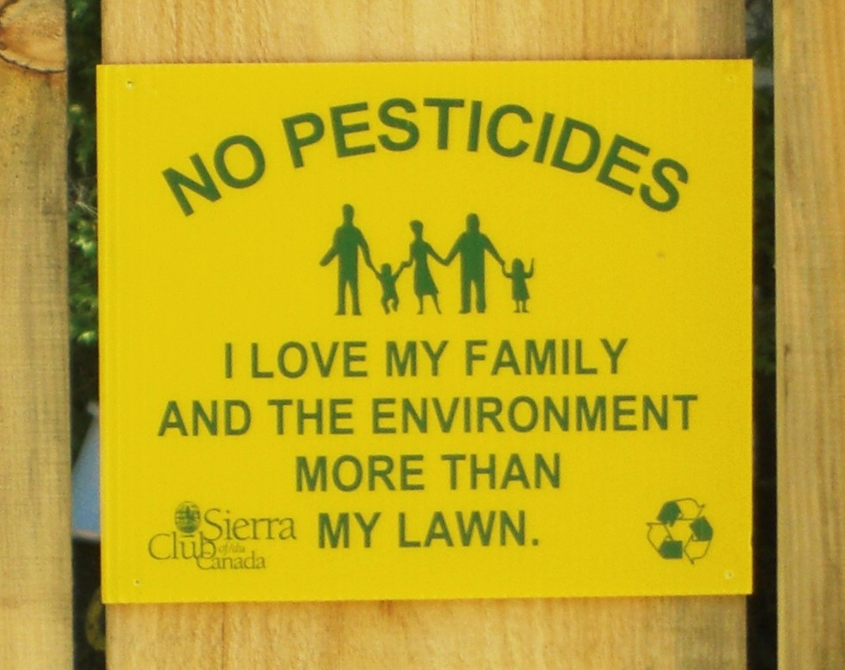
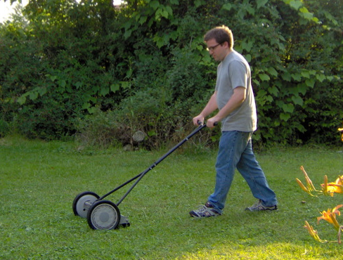
3
What Can You Do about It?
Reduce pollutants
Refrain from using chemical fertilizers, herbicides, and pesticides. Look into natural alternatives!
Leave lawn clippings and leaves instead of sending them to a landfill.
If you use a gas mower, mow less frequently. Switch to an electric mower or even a push (reel) mower if you can.

Slide 6
Credits
Photos used under Creative Commons licenses:
https://creativecommons.org/licenses/by-nc/2.0/legalcode
“Pine Marten” by SolidElectronics via flickr.com
“Old House 08, Liberty Reservoir” by David Heise via flickr.com (cropped)
“Pollution From Mowing” by George Morris via flickr.com (cropped)
“No Pesticides” by Toban B. via flickr.com (cropped)
“The New Rain Barrel With a Rain Chain” by Ken Mayer via flickr.com
https://creativecommons.org/licenses/by-sa/2.0/legalcode
“Natural Meadow” by Chesapeake Conservation Landscaping Council via flickr.com (cropped)
https://creativecommons.org/licenses/by-nc-nd/2.0/legalcode
“Manual Labor” by TheBazile via flickr.com (cropped)

